Slide 1
A Seminar on TICKETING SYSTEM using Blockchain Technology
Team Details
A.RAKSHITH REDDY (20EG105505)
K.SRAVAN KUMAR (20EG105527)
M.YASHWANTH REDDY (20EG105533)
Project Supervisor
Name : P.VINAYASREE
Designation : Asst. Professor

Slide 2
Introduction
Are you sick and weary of secondary market uncertainties, bogus duplication, and ticket scalping? We are thrilled to present a ground-breaking blockchain-based ticketing system. Buying, selling, and managing your event tickets is made simple, transparent, and safe with the help of this cutting-edge platform.
Blockchain Ticketing: What Is It?
Blockchain is a distributed ledger that keeps track of transactions via a computer network. Several benefits are provided by this technology for ticketing systems:
Unmatched Security: Tickets are kept on the blockchain as distinct, unchangeable tokens, removing the possibility of fraud or duplication.
Transparency for All: Each and every transaction is documented on the blockchain, giving each ticket a full and authenticated history.
Fair and Secure Resale: By eliminating scalping and guaranteeing fair pricing, the platform makes ticket resale transparent and safe.
Applications:
Enhanced Security and Reduced Fraud
Transparent Secondary Market
Improved Fan Engagement
Streamlined Ticketing Process

Slide 3
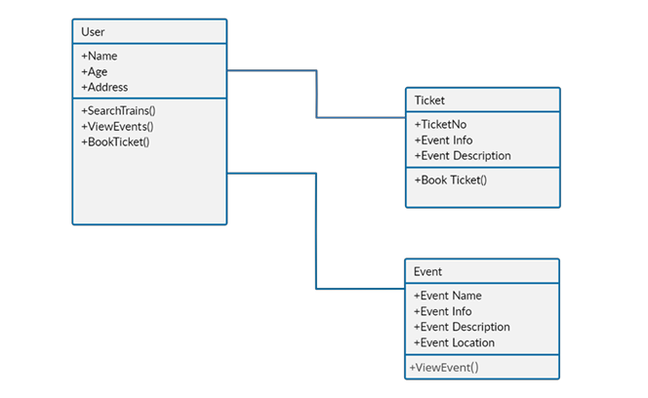
Concept Tree

Slide 4
Literature
Author(s) | Strategies | Advantages | Disadvantages
Chris Dixon | Broader implications of decentralized technologies in NFT | Insights into the potential transformative impact of blockchain and NFTs on various industries. | May not specifically delve into specific strategies but provides a broader context for understanding the technology.
Mariano Conti | Decentralized finance (DeFi) and NFTs | Provides insights into the potential financial implications and synergies between NFTs and DeFi. | Focuses more on the financial aspects and may not cover a wide range of NFT strategies.
Chris Burniske | Valuation of digital assets, including NFTs | Provides insights into the valuation and economic aspects of digital assets, including NFTs. | May not focus exclusively on specific NFT strategies for creators or investors
Devin Finzer | Marketplace dynamics and trends. | Deep insights into the mechanics of NFT marketplaces and the evolving landscape. | May be more focused on the operational aspects of NFTs rather than broader market strategies.

Slide 5
Problem Statement
The many issues with our current ticketing system annoy event planners as well as attendees. Ticket counterfeiting and scalping result in lost profits for organizers and inflated or even fraudulent prices for attendees. Reselling tickets via unofficial means is risky since there's no way to know if they're authentic and little to lose if they aren't. From purchase until admission, the entire procedure may be drawn out, tedious, and fraught with needless costs. The tickets are only passes for access; they don't come with any extra benefits or ways for attendees to interact with the event. Imagine a situation where a fan has been saving money for their favorite band's performance for months, only to discover at the venue that their ticket is a fake. There is a great deal of disappointment and frustration. This is but one illustration of the issues ailing the present framework. We require a new ticketing system that puts efficiency, openness, and security first. In addition to safeguarding attendees and organizers, this will make the event run more smoothly and happily for all.
Everyone finds the present ticketing system to be a pain. Inflated pricing and phony tickets put fans at risk of frauds. Reselling has no assurance of authenticity, thus it's a risk. The procedure is cumbersome, sluggish, and expensive. Tickets have no additional value; they are merely tickets for entry. Imagine putting money down for a concert, only to have your phony ticket confiscated. We require an improved system that is safe, open, and effective and that helps organizers and spectators alike.

Slide 6
Problem Illustration
Everyone engaged suffers from a mess caused by the present ticketing system. Say Sarah is a concertgoer who has been saving money for her favorite band's performance for months. She enters the arena with ease thanks to a valid ticket, but David, another fan, is nervously waiting in line with a resale ticket in hand. Even if it is true, David isn't sure, and the procedure has been difficult. This situation demonstrates the issues: scalping exposes fans like David to inflated costs and fakes, and the overall ticketing procedure is annoying for everyone due to potential frauds and lengthy lineups. In order to ensure a seamless and enjoyable experience for both spectators and event organizers, a new system that puts an emphasis on security, transparency, and ease of use is required.
In the event of a transparent and safe system, David wouldn't have to question the legitimacy of his ticket. Secure digital wallets or blockchain technology have the potential to completely eradicate counterfeiting. Imagine a system where Sarah could simply obtain her ticket and utilize it to gain access to secure meet-and-greet opportunities, merchandise discounts, and unique content. This adds value above and beyond mere admission and enriches the fan experience. Both parties would benefit from this new ticketing system. Event planners might gain from more revenue, less fraud, and happier guests, while fans would be safe and have a more interesting experience. In this scenario, attendees will be able to fully enjoy the event without having to deal with the current mess that is ticketing.

Slide 7
Proposed Method
Imagine a secure online ticket vault. This vault, built on blockchain technology, eliminates the middleman and creates unique digital tickets for each event. These tickets can't be forged and are easily transferred between fans directly on the platform. Fans win with lower fees and a safe way to resell tickets. Event organizers benefit from reduced fraud and the ability to connect directly with fans through the platform.
To ensure ticketing system on blockchain networks, we propose several strategies tailored to enhance security, efficiency, and trustworthiness:
Blockchain Ticketing Platform: Clear Secondary Market: Using the blockchain technology, enable a safe secondary market for tickets. With smart contract-enforced regulations, users may resell tickets and avoid scalping while guaranteeing fair pricing.
Smart Contracts for Ticketing: Make smart contracts that run on their own to control the ticketing procedure. These agreements will specify the characteristics of the tickets, oversee their issue, transfer, and resale, and implement the regulations set forth by the event organizer (such as price caps and resale limitations).
Secure User Management: Provide a safe user management platform for both event planners and participants. On the platform, users may register, buy tickets with bitcoin or conventional payment methods, and manage their ticket accounts.
Transparent Secondary Market: Create a safe secondary ticket market by utilizing the blockchain technology. With smart contract-enforced regulations, users may resell tickets and avoid scalping while guaranteeing fair pricing.

Slide 8
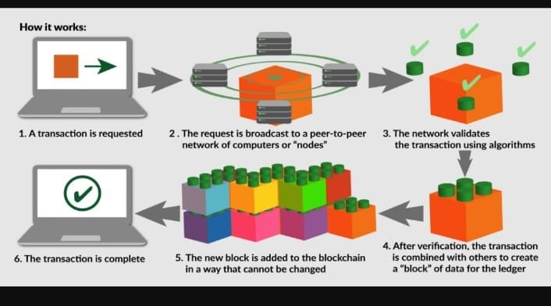
Proposed Method Illustration
Login with metamask
creates unique tickets
Fans buy tickets with ease
Blockchain Network Validation
Transaction Confirmation
Interoperability and Integration
Continuous Monitoring and Incident Response

Slide 9
Parameter
Although ticketing apps can benefit from a transparent and safe basis provided by blockchain technology, it is uncommon for formulae to be used directly in the fundamental functions. But there are certain situations in which formulas may be useful:
1. Fees for transactions:
Formula: *Gas Price * Transaction Fee Gas Utilized
Gas Price: The amount a user is willing to spend for each compute unit (or gas) needed to complete a blockchain transaction. Usually set by the user, this varies according to network congestion.
Gas Used: The quantity of gas used on the blockchain to carry out a certain transaction. This is contingent upon the intricacy of the smart contract in question.
2. The Logic of Smart Contract Pricing:
Dynamic Pricing (Optional): A smart contract may be used to incorporate a formula-based ticket pricing strategy. This might take into account things like:
Base Price: A predetermined amount that the event planner sets.
Demand Factor: A formula (derived from purchase history or user interest data) that raises the price in response to increasing demand for the event.
Time Factor: An algorithm that modifies the cost according to how close an event is to taking place (e.g., offering discounts closer to the event).
Important Note: In order to prevent user annoyance, dynamic price implementation can be complicated and needs careful thought.

Slide 10
Experiment Environment
HARDWARE SPECIFICATION
Processor : i5 Processor, Ryzen 5 above
Ram : 8 Gb and above
Hard Disk : 256 GB.
GPU : GTX 1650
SOFTWARE SPECIFICATION
Operating System : Windows.
Programming Language : JavaScript, Solidity, Node.js
IDE : VS code
Blockchain dev framework : web3.js, Ganache

Slide 11
Project status
S.No | Functionality | Status (Completed /in-progress/Not started)
1 | Abstract | Completed
2 | Requirements | Completed
3 | Paper Writing and Journel Submission | Not Yet Started
4 | Implementation | In Progress

Slide 12
References
[1] H. -Q. Nguyen, H. T. Nguyen and T. -T. Pham, "Applying Smart Contract in Blockchain Technology to Manage the Ticketing Issuance and Ticketing Traceability," 2023 IEEE Jordan International Joint Conference on Electrical Engineering and Information Technology (JEEIT), Amman, Jordan, 2023, pp. 160 164, doi: 10.1109/JEEIT58638.2023.10185771.
[2] G. Elizabeth Rani, G. Narasimha Murthy, M. Abhiram, H. Mohan, T. Singh Naik and M. Sakthimohan, "An Automated Airlines Reservation Prediction System Using BlockChain Technology," 2021 Sixth International Conference on Image Information Processing (ICIIP), Shimla, India, 2021, pp. 224-228, doi: 10.1109/ICIIP53038.2021.9702587.
[3] R Y. YuanJiang and J. T. Zhou, "Ticketing System Based On NFT," 2022 IEEE 24th International Workshop on Multimedia Signal Processing (MMSP), Shanghai, China, 2022, pp. 01-05, doi: 10.1109/MMSP55362.2022.9948706.
[4] X. Luo, M. Zhou, Y. Xia, Q. Zhu, A. C. Ammari, and A. Alabdulwahab, ‘‘Design of Work Ticket System and Scheduling Algorithm based on Blockchain,’’ IEEE Trans. Neural Netw. Learn. Syst., vol. 27, no. 3, pp. 524–537, Mar. 2016.
[5] J. Biryukov, D. Khovratovich, and I. Pustogarov, “Deanonymisation of clients in bitcoin p2p network,” in Proceedings of the 2014 ACM SIGSAC Conference on Computer and Communications Security, ser. CCS ’14. New York, NY, USA: ACM, 2014. 47

Slide 13
Thank you

